Slide 1
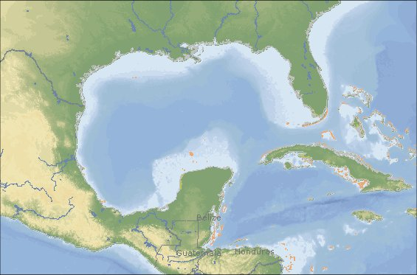
AUTONOMOUS UNDERWATER VEHICLES IN THE GCOOS-RA FOOTPRINT
A HOOK FOR TEACHING HOW DATA ARE USED IN THE REAL WORLD
C. Simoniello, C. Lembke, G.J. Kirkpatrick, R.H. Weisberg, B.A. Kirkpatrick, A.E. Jochens, M.K. Howard, S. Walker, C. Szczechowski, J. Cannizzaro, and D. English

Slide 2
Background
The health of the Gulf of Mexico is vital to the well-being of the nation
TX, LA, MS, AL and FL have a GDP of $2.2 Trillion*
Oil and Gas; Tourism; Ports (11 of top 15 tonnage ports in the U.S.**); Commercial Fisheries (4 of top 7 U.S. fishing ports by weight)***
Students from Gulf Coast States Perform Poorly on STEM Assessments
2011 U.S. H.S. Science and Engineering Readiness Index^: Texas, Alabama, Louisiana, and Mississippi ranked 31, 47, 48, and 50, respectively; Far below the national average. FL is the exception, ranking 11th.
The GCOOS-RA is working with its partners to address the deficiency in STEM skills required to:
Manage the living resources of the GOM; Make informed voting decisions; Power the future workforce; Compete in a global economy
*2006 Bureau of Economic Analysis International Monetary Fund; **2004 USACOE Navigation Data Center; ***2010 NMFS; ^American Institute of Physics
Notes:
Oil and gas 27% domestic crude;

Slide 3
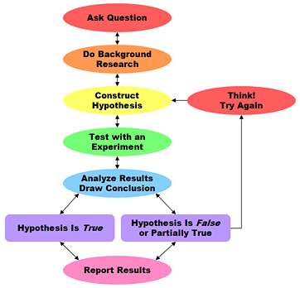
Selecting Issues of Relevance to Students
Examples of the Scientific Process in progress that demonstrate the relevance of STEM disciplines to the everyday lives of GOM students:
Harmful Algal Bloom Research
Deepwater Horizon Oil Spill Research
Complement current regional research priorities
GCOOS-RA, GOMA, Gulf Coast Ecosystem Restoration Task Force, and GOM Large Marine Ecosystem Projects

Slide 4
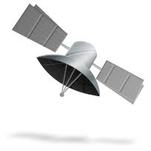
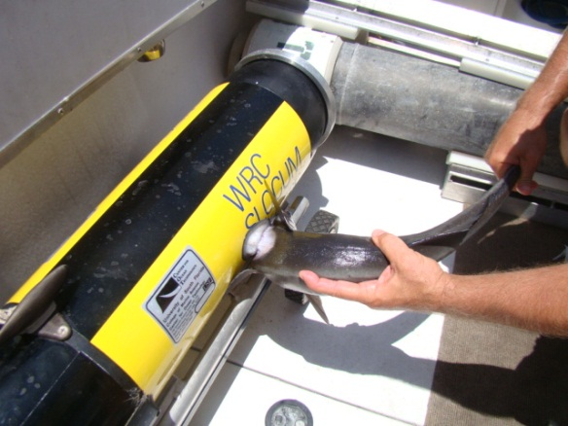
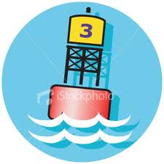
Why Integrate Data?
Sensors on different platforms are used to monitor ocean conditions
SPATIAL RESOLUTION
TEMPORAL RESOLUTION
Satellite Remote Sensing
Typically a ‘snapshot’
(low temporal
resolution) of a large
area (high spatial resolution)
Fixed Platform
Typically information about
a limited area (low spatial
resolution) provided for a
prolonged period of time
(high temporal resolution)
Gliders/AUV
Intermediate: provides
large spatial coverage for extended periods of time.

Slide 5
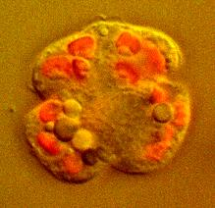
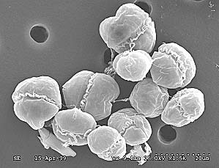
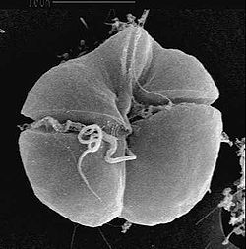
Detecting Harmful Algal Blooms in the Gulf of Mexico
Cells with chlorophyll fluoresce (emit light). The light is emitted at certain wavelengths (~678 nm) or bands.
Irradiance sensors mounted on satellites measure the amount of radiance (light) leaving the sea surface. The sensors are set to measure light at 667 nm and 748 nm, wavelengths bracketing the fluorescent band of chlorophyll.
Fluorescence Line Height (FLH) is a relative measure of the amount of radiance leaving the sea surface in the chlorophyll fluorescence emission band.
Other compounds in seawater besides chlorophyll (e.g., suspended sediments, algae, protists), can also emit light.
Researchers must determine what part of the signal is due to chlorophyll in the water, and what is due to other materials.

Slide 6
Tampa Bay
Sarasota
Port
Charlotte

Slide 7
10/05/2011
10/21/2011
Suspended sediment
Windy conditions preceding 10/21/2011 led to high suspended sediment concentrations. FLH values for K. brevis blooms are overestimated during sediment resuspension events and are not reliable for identifying chlorophyll-rich waters. Go to the GCOOS data portal (http://gcoos.tamu.edu/products/) and locate a buoy in the vicinity of the bloom (try C14). Select ‘wind gusts’ and set begin/end dates about one week prior to 10/21. Plot the wind conditions on a graph. Internet or ‘canned’ data options.

Slide 8
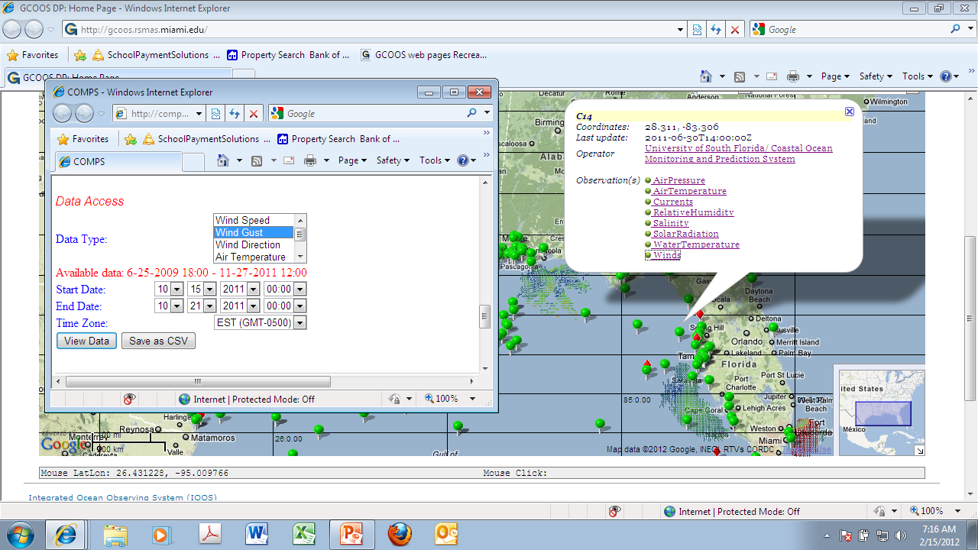
Wind data are reported every 20 minutes (=72 data points/day). Students will have to think
about how to graph: average all or a range of values; select one time for consistency.

Slide 9
USF COT glider Bass track
10/12 to 11/08/2011 (28 days,
38 km; max depth 39.1 m)

Slide 10
Way Points WP2 and WP 7 are at the same location, approximately two weeks apart.
Using the temperature and salinity graphs, how might you explain the obvious difference
In density from WP2 and WP 7?

Slide 11
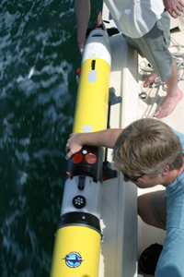
Plot air temp to
emphasize
air-sea
interactions .
http://www.wunderground.com/history

Slide 12
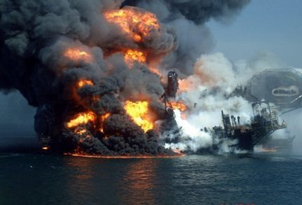
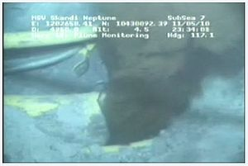
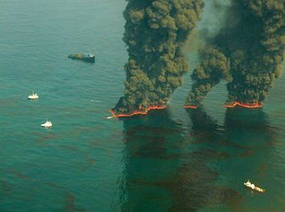
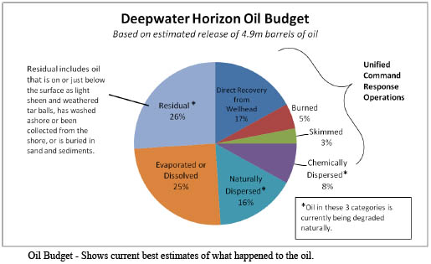
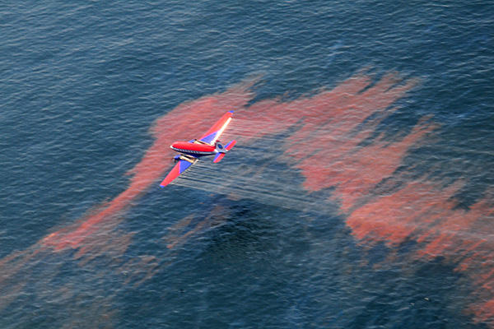
The Deepwater Horizon Oil Spill
April 20, 2010 DWH platform
exploded 50 mi. SE of the MS Delta
and sank ~ 5,000 ft. beneath sea surface.
Oil flowed freely until July 15, 2010
How much crude oil is flowing?
Not really sure.
ROV Image Ignites Flow Rate Debate
225 controlled burns
remove >11.1 M gal
1.85 M gal dispersants
(surface and subsea)
34.7 M gal oily water
recovered
NOTE: Reported by NOAA and USGS…not
peer-reviewed literature
4.9 M barrels ~ 205 M gal …where is the rest?
Notes:
Geographic extent: Loop Current, water column
Attempts to stop leak: subsea and surface strategies

Slide 13
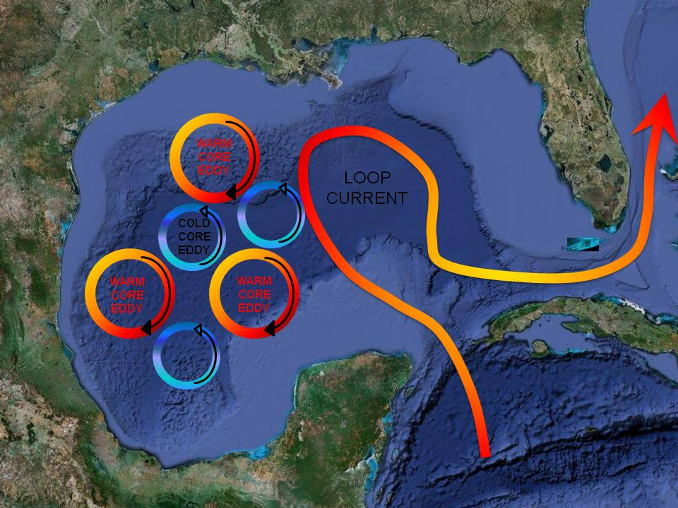
Where Will the Oil Go?: Integrating Data Sets to Predict Circulation Patterns
Model outputs
for 1 June 2010.
Models all
predict oil
near the WFS.
Liu et al., 2011
Where is the Loop Current?
Satellites: MODIS
Aqua-1 true color
Oil Spill at DWH
oil rig. Estimates
of oil from
satellites did not
mesh with
flow estimates.
LSU ESL
Temperature comparison 6/2010:
Model limitations under-predict
upwelling & emphasize need for data.
English et al., 2012
WFS ROMS
Glider

Slide 14
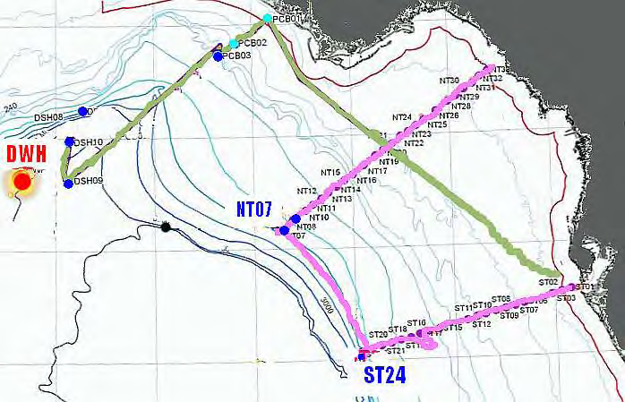
SHIP: USF locations of bio-optical profiles
May-August 2010.
GLIDER (top right): Bio-optical sensors on AUVs show a distinct backscatter anomaly near a DWH oil patch.
Ship-based CTD casts (right): Transmissometer and chl fluorometer
and 6-channel backscattering
meter (interpolated to 660 nm) from two stations near the DWH
site. Three casts at station NTO7 (blue, magenta, red dots); one at
NT08 (green dots).
Data from D. English et al., 2012

Slide 15
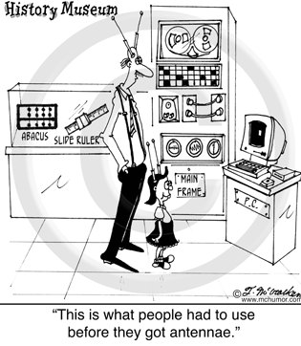
Questions?

Slide 16
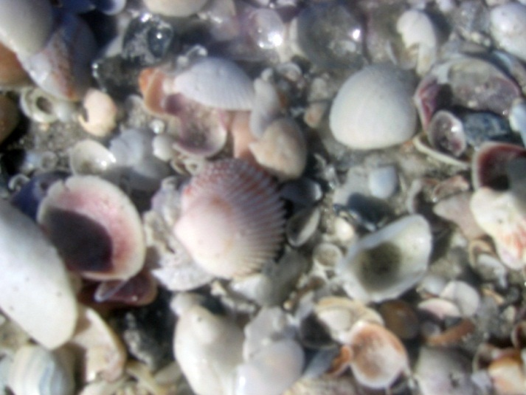
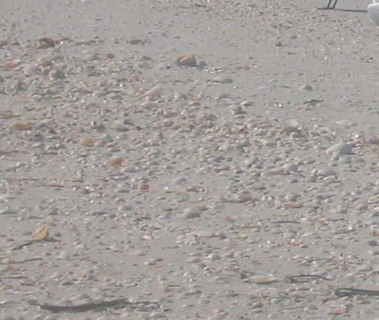
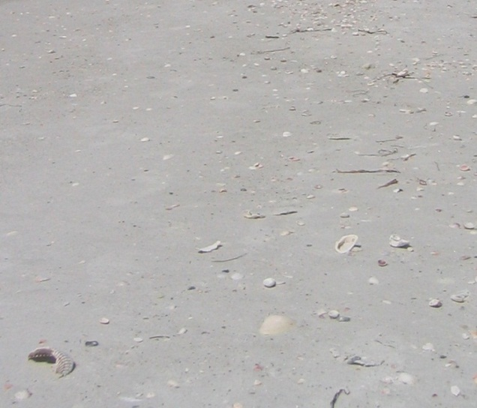
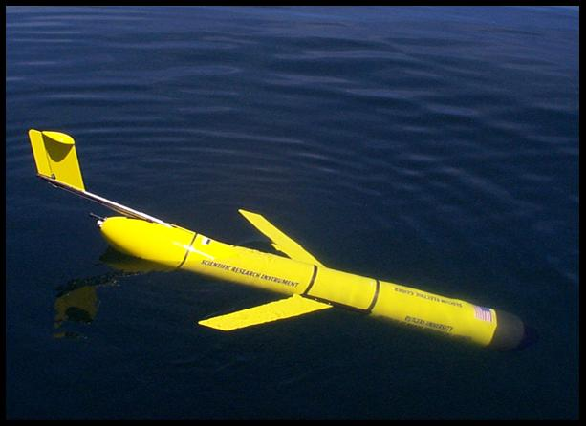
Beach Sediment as an Example of Resolution
SPATIAL RESOLUTION
Frame challenging topics using familiar examples and analogies.

